Slide 1
MSBA 285: Captsone 1
Dylan Bernardi
Real-Time Stock Market Sentiment & Price Analysis
PREDICTING MARKET MOVEMENT USING NEWS, TWITTER & TECHNICAL INDICATORS
Jeet Singh Saini

Slide 2

Home
About
Contact
Project Objective
INTRODUCTION
Build a full-stack system that forecasts short-term stock price movement using:
Real-time sentiment from news & Twitter
Stock price data from Yahoo Finance & Twelve Data
Machine learning classification models
Provide real-time insights via Streamlit & Grafana dashboards.

Slide 3
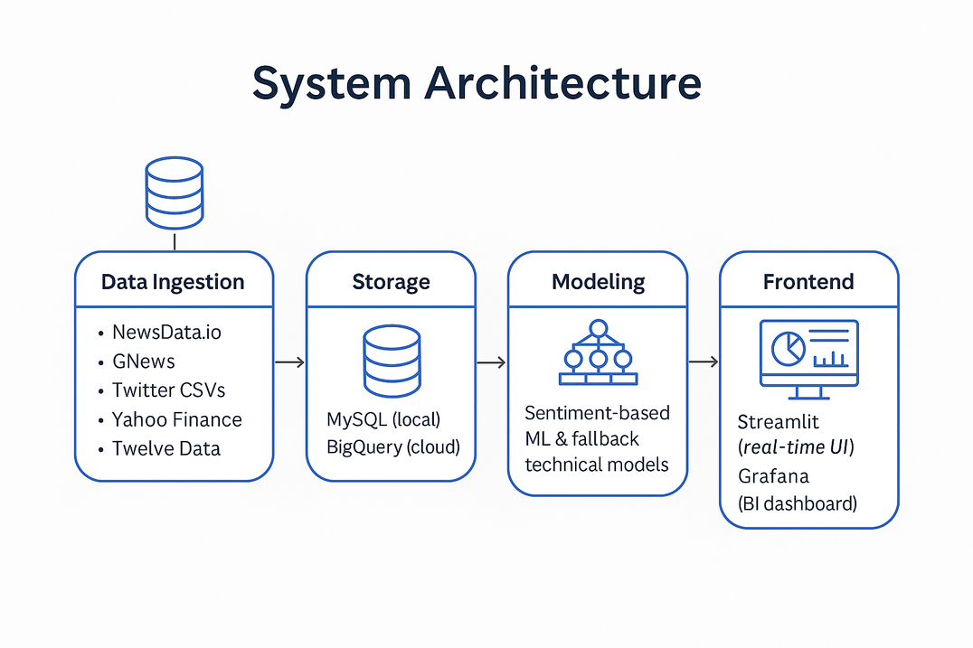
Home
About
Contact
System Architecture
PREDICT. VISUALIZE. DECIDE
Data Ingestion: NewsData.io, GNews, Twitter CSVs, Yahoo Finance, Twelve Data
Storage: MySQL (local) and BigQuery (cloud)
Modeling: Sentiment-based ML & fallback technical models
Frontend: Streamlit (real-time UI) + Grafana (BI dashboard and real-time)

Slide 4









Home
About
Contact
Data Sources
SENTIMENT
Twitter Data (cleaned CSVs)
NewsData.io & GNews API
STOCK PRICES
Yahoo Finance (default)
Twelve Data (fallback API)
TARGET STOCKS

Slide 5
Sentiment Analysis & Preprocessing
Home
About
Contact
CLEAN. SCORE. LEARN
Sources: NewsData.io (real-time) and GNews (historical), along with Twitter data (historical) in CSV format.
Cleaning & Tokenization:
HTML tags, special characters, and duplicate headlines removed.
Text is lowercased, tokenized, and normalized using basic NLP techniques.
Sentiment Scoring:
VADER sentiment analysis is applied to compute compound sentiment scores.
Scores range from -1 (very negative) to +1 (very positive).
Storage:
Cleaned and scored data is saved in the combined_sentiment_data SQL table.
Aggregation:
Average sentiment is computed for each stock over a 2-hour rolling window.
This becomes a core input feature for the sentiment-based prediction model.
Deduplication: News deduplication is performed using cleaned-text hashes to avoid biasing scores with repeated articles.

Slide 6
Home
About
Contact
Modeling Approach
PRIMARY MODEL
FALLBACK MODEL
ALGORITHMS
Logistic Regression
Random Forest
XGBoost (best in recent runs)
Sentiment + Time features (hour, day, month)
Technical indicators (returns, volatility, EMA, SMA, RSI)

Slide 7

Home
About
Contact
Prediction Pipeline
RUN AS BACKEND/MAIN.PY
Steps:
Merge sentiment with price history
Train/update models
Make real-time predictions
Save to MySQL & BigQuery

Slide 8
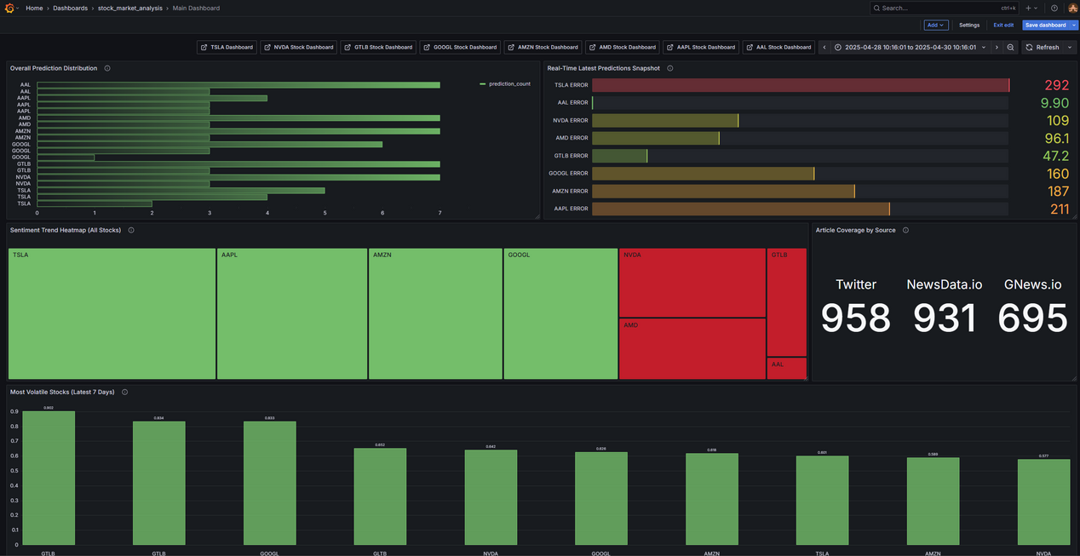
Grafana
Home
About
Contact
VISUALIZE. COMPARE. ACT
Real-time dashboard built with Grafana and powered by BigQuery
Enables interactive monitoring of market sentiment and model predictions
Key panels include:
Latest model prediction per symbol with confidence score
Time series visualization of UP / DOWN / NEUTRAL predictions
Sentiment vs. Price correlation matrix to detect alignment and divergence
Designed for analysts, traders, and executives to gain rapid insights

Slide 9
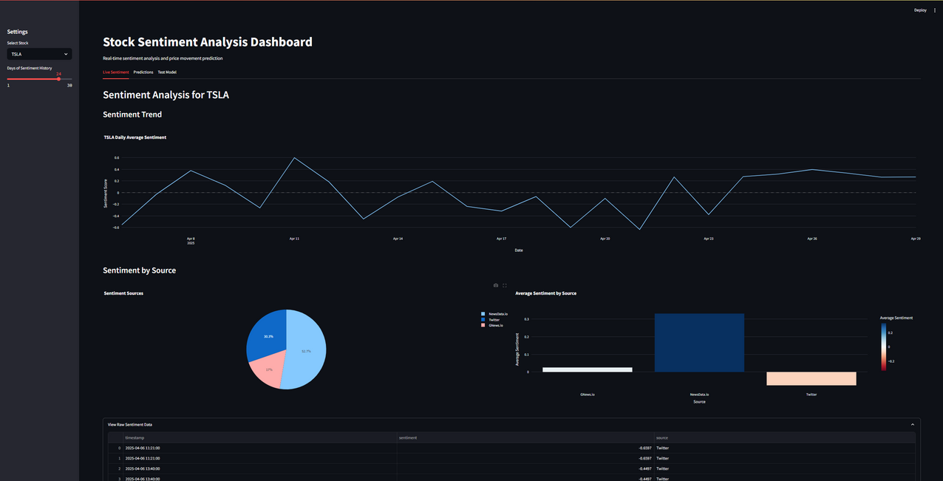
Streamlit Dashboard
Home
About
Contact
INSIGHT AT GLANCE
Real-time display of prediction, price, and sentiment score
Dropdown selector for tickers with instant updates
Dark-themed, responsive layout for clean visual focus
Pulls live data from real_time_predictions (MySQL)
Built for fast insights and user-friendly interaction

Slide 10
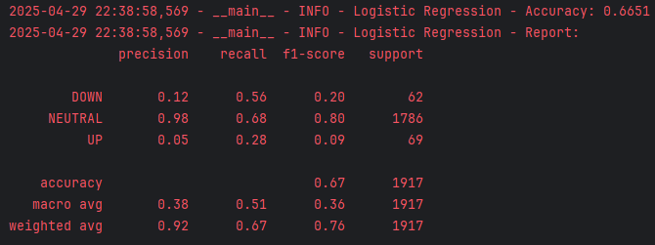
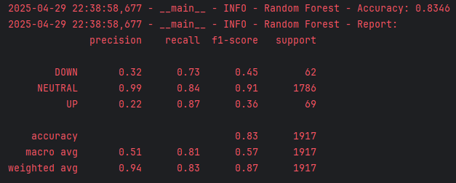
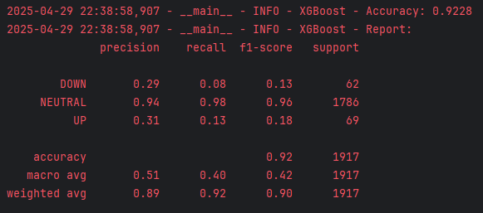
Evaluation Metrics
Home
About
Contact
INSIGHTS THROUGH METRICS
Top Performance:
Precision and recall highest for NEUTRAL class
F1-Score ~0.97 for NEUTRAL
Challenges Observed:
Significant class imbalance: NEUTRAL makes up ~94% of labels
DOWN and UP classes underrepresented, reducing model sensitivity
Next Steps:
Address imbalance with SMOTE, resampling, or class-weighting
Explore ensemble techniques for rare-class amplification

Slide 11
Challenges
Home
About
Contact
BARRIERS TO BRILLIANCE
API RATE LIMITS
DATA SYNC ISSUES
Frequent throttling from Yahoo Finance and Twelve Data required fallback handling and sleep intervals.
Mismatched timestamps across APIs, SQL, and BigQuery caused alignment problems.
SENTIMENT GAPS
DASHBOARD DELAYS
Incomplete or missing sentiment for less active stocks like AAL, leading to frequent use of fallback models.
Grafana sometimes displayed stale results due to query caching and update lag.
CLASS IMBALANCE
Heavy bias toward NEUTRAL labels reduced model precision on UP/DOWN predictions.

Slide 12
Home
About
Contact
Conclusion & Future Work
Successfully integrated data, models, and dashboards
High-frequency updates enable real-time forecasting
FUTURE ADDITIONS:
Reddit sentiment
LSTM or Transformer-based models
Trade signal alerts

Slide 13
Home
About
Contact
Thank You
START YOUR INVESTMENT JOURNEY

